Slide 1
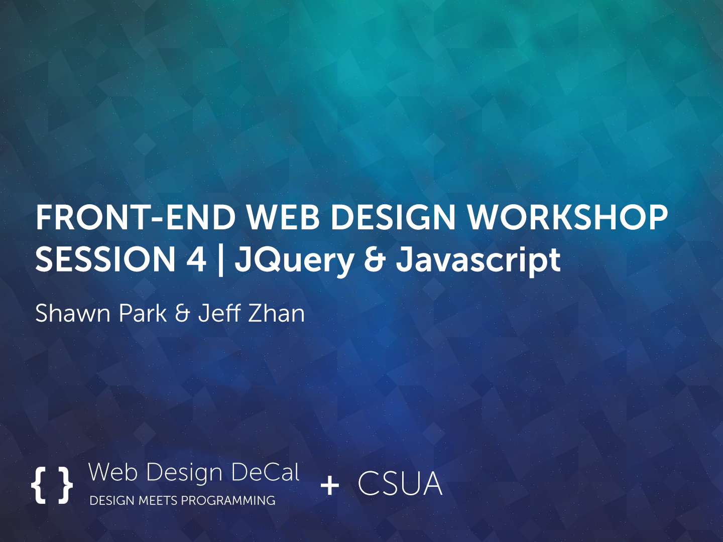

Slide 2

Intro to JavaScript

Slide 3
Intro to JavaScript
JavaScript is the scripting language of the web
Not the same as Java!
Like CSS, you can select elements and manipulate their actions
Hide/Unhide menus
Photo Slider (carousel)
Popup modals (like Facebook’s Photo Viewer)
Form Validation
One-Scroll Homepage

Slide 4
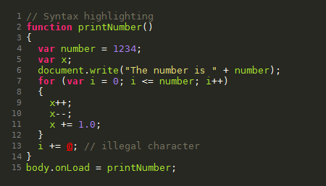
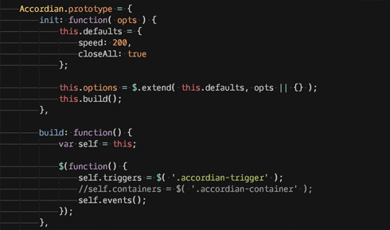
Intro to JavaScript
Sample JavaScript:

Slide 5
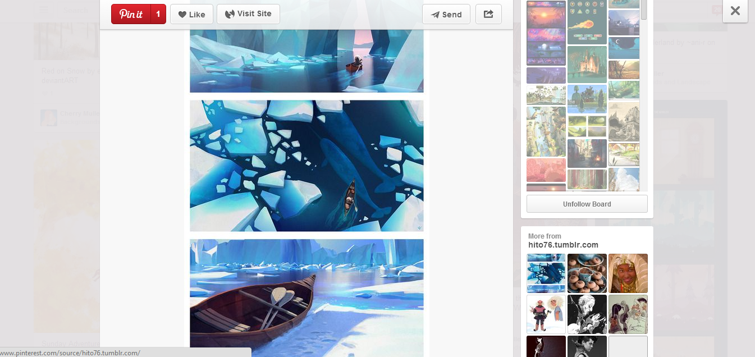
Intro to JavaScript - Examples
Pinterest - Modals

Slide 6
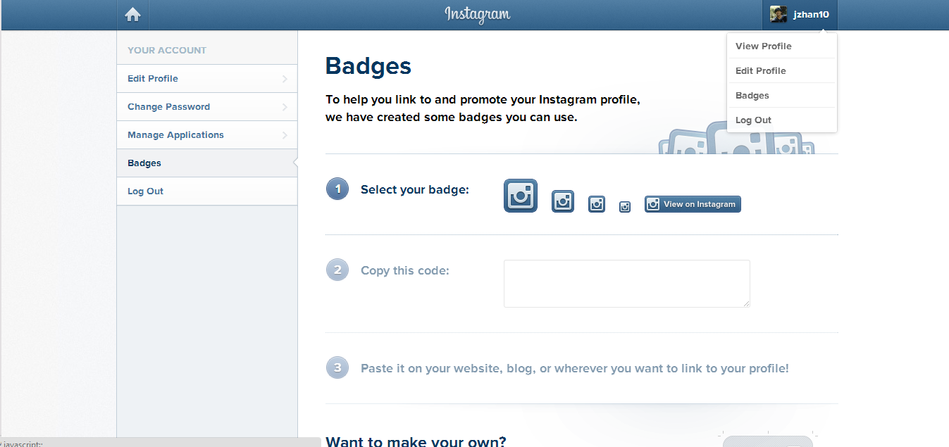
Intro to JavaScript - Examples
Instagram - Toggling Menus

Slide 7
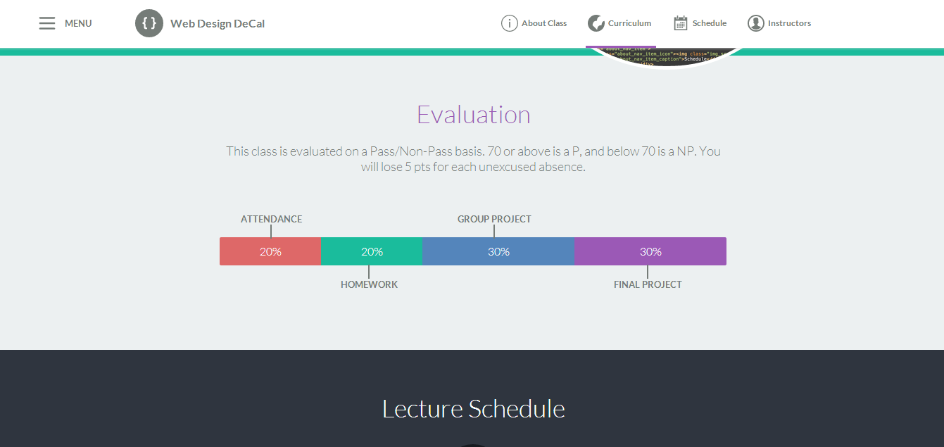
Intro to JavaScript - Examples
Decal Site – Menu Changes with Scroll

Slide 8
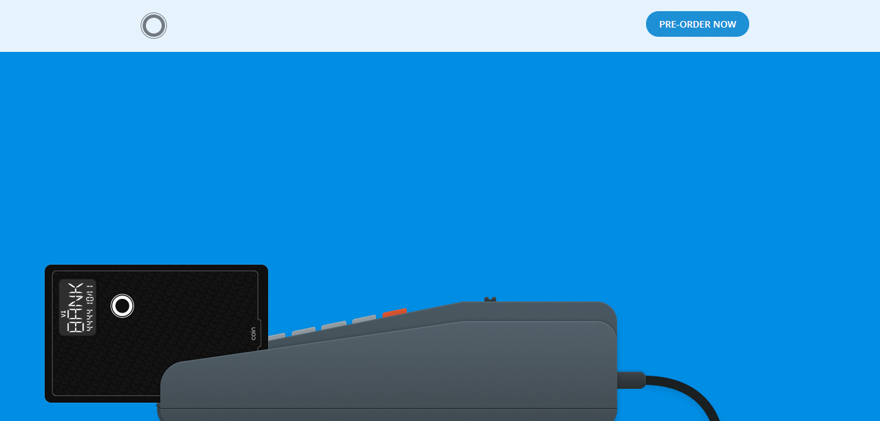
Intro to JavaScript - Examples
Coin – JavaScript animations while scrolling

Slide 9
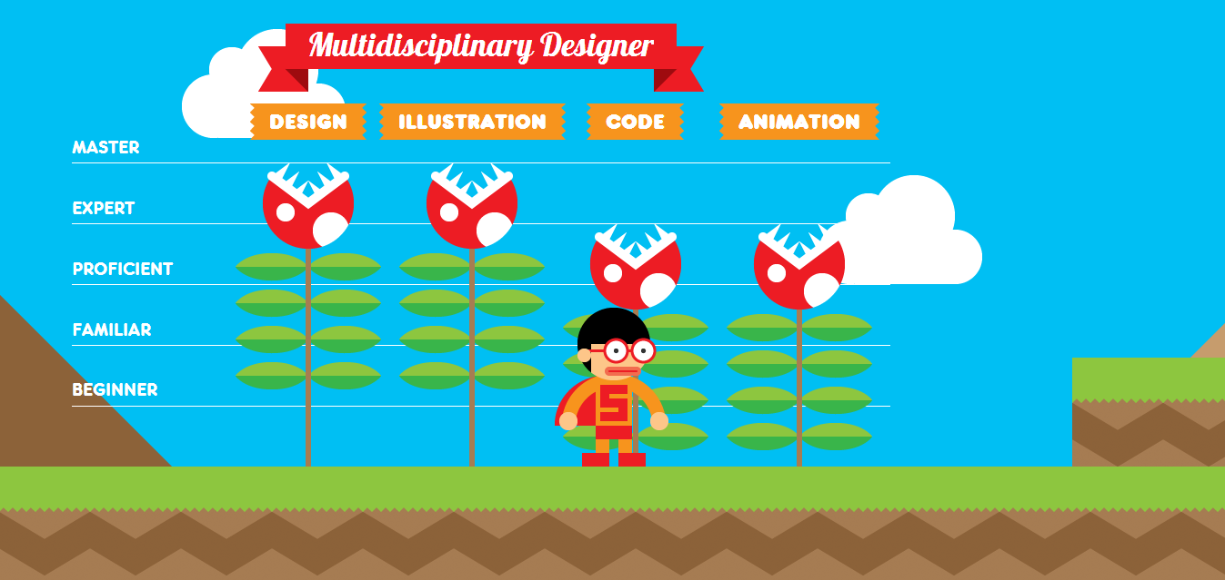
Intro to JavaScript - Examples
Interactive Resume (http://www.rleonardi.com/interactive-resume/)

Slide 10

Intro to JavaScript - Examples
GameTrailers – Photo Slider

Slide 11
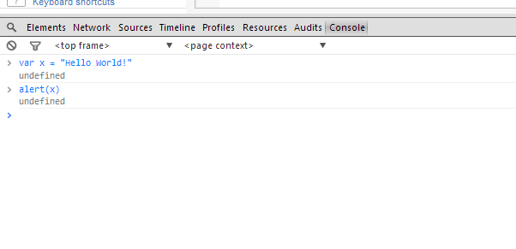
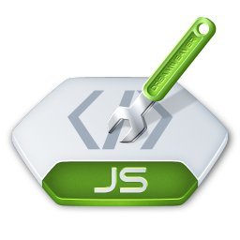
Intro to JavaScript
How to you use Javascript?
Like CSS, you link to a separate .js file that contains your file
<script type=“text/javascript” src=“home.js”></script>
You can also test JavaScript in Chrome’s console (Inspector Element window) and on JSFiddle.net
Let’s start coding!

Slide 12
Basic Syntax
Variables
They take in numbers, text, booleans (true/false) and functions
var x = 8;
var y = “John”
var z = ‘Smith’
var a = true;
Text (in computer science, we call them “strings”) can be surrounded by single or double quotes
Concatenation
You can add numbers or combine “strings”
var a = x + x;
var b = y + “ “ + z;
var c = 5 + “ five”;
“a” now stores 16. “b” stores John Smith.
Note: only use “var” to initialize (if the variable name has never been used before)

Slide 13
Basic Syntax
Shorthand increment/decrement
var x = 1;
x = x + 1;
// x is now 2
x += 1;
// x is now 3
x++;
// x is now 4
x--;
// x is now 3
To increment by 1, there are 3 ways:
1) x = x+1
2) x += 1
3) x++
Same goes for decrementing

Slide 14
Conditionals
If… Else…
If something do this, else do that
If(x > 9000) {
alert(“Over 9000!”);
} else {
console.log(“Weak”);
}
alert(…) is a JavaScript function that creates a popup.
console.log(…) outputs whatever is inside onto the console (e.g. Chrome’s console).
Both useful for debugging.
Plain If, and If…Else If… Else If…
if(z < 9000) {
alert(“Not Saiyan”);
}
if(z == 1000) {
…
} else if (z == 2000) {
…

Slide 15
Conditionals
Comparisons
<, >, >=, <=
== and === (3 equal signs checks value and type)
var x = 3;
x == 3 // true
x === “3” // false
x === 3 // true
And/Or - &&/||
if((x==3) && (y==5)) {
…
if(x || y) {
….

Slide 16
Conditionals
Not Equal - !=, !== (not same type too)
if(x != y) {
…
}
Remember, you can use ( ) parentheses to separate your logic. (e.g. if((x != 3) && (y != 4)) )

Slide 17
Arrays
Variables can also store more than 1 value
var x = new Array(“Porsche”, “BMW”, “Ferrari”);
or
var x = [“Porsche”, “BMW”, “Ferrari”];
or
var x = new Array();
x[0] = “Porsche”;
x[1] = “BMW”;
x[2] = “Ferrari”;

Slide 18
Arrays
Access an array with […]
First value is always the array position. Positions start at 0
var x = [“Porsche”, “BMW”, “Ferrari”];
alert(x[0]); // Will alert “Porsche”
Set values for an array
x[2] = “Tesla”;
You can get an array’s length with arrayname.length
x.length // returns 3. However, max position is 2, since we start at 0

Slide 19
Loops
For Loop
Loop through items/arrays
3 components
for(var i=0; i < 10; i++)
1st value initializes variable. i++ increments i by 1 after loop is complete. Loop while i < 10, and stop when condition is not met.
var cars = [“Porsche”, “BMW”, “Tesla”];
for(var i = 0; i < cars.length; i++) {
alert(cars[i]);
}
// alerts each value in cars, one by one

Slide 20
Loops
While Loop
Loop through items/arrays
1 component
while(i < 30) { … }
Initialize (var i = 0) before while loop, increment (i++) inside
var i = 0;
while(i < 30){
alert(i);
i++;
}
// alerts values 0 to 29
Warning!
If you don’t increment, or don’t fail the conditional statement at some point, you end up in a never-ending loop! Not good!

Slide 21
Loops
For vs. While
For loops are more compact
But while loops are fast to type
for(var i=0; i<100; i++) {
alert(i);
}
var i = 0;
while(i < 100) {
alert(i);
i++
}
Output: 0, 1, 2, … , 98, 99

Slide 22
Functions
Functions are a set of JavaScript code, that can perform some action, return a result, or do computation
They take in 0 or more arguments (values to be passed in)
Arguments are by default type var, so arr can be any var
function printOddValues(arr) {
var odd = true;
for(var i=0; i<arr.length; i++) {
if(odd){
console.log(arr[i]+” “);
odd = false;
} else {
odd = true;
}
}
}
Once you have a function, you can call it!
var arr = [1, 2, 3, 4, 5, 6, 7];
printOddValues(arr);
Output: 1 3 5 7
var arr = [“OH”, “CA”, “PA”, “NY”];
printOddValues(arr);
Output: OH PA

Slide 23
Functions
Functions can return values, and you can save them in a variable (for future use)
function calculateExp(value, times) {
if(times < 0) {
return -1;
} else if(times == 0) {
return 1;
} else {
var count = 1, total = 0;
while(count <= times) {
total += value;
}
return value;
}
}
Let’s call this function!
var x = calculateExp(5, 3);
alert(x);
Output: 125
var x = calculateTimes(10, -999);
if(x != -1){
alert(“No neg nums please”);
}
Output: “No neg nums please”

Slide 24

JavaScript
Functions and variables are cool… but can we do more with JavaScript?
jQuery, a JavaScript library, comes in handy!
jQuery allows you to access HTML elements and do all sort of things!
Click events
Keyboard presses
Scrolling animations
Modal popups
Toggling menus
Smoother hovers and animations
Etc.

Slide 25
Intro to jQuery

Slide 26

jQuery
Functions and variables are cool… but can we do more with JavaScript?
jQuery, a JavaScript library, comes in handy!
jQuery allows you to access HTML elements and do all sort of things!
Click events
Keyboard presses
Scrolling animations
Modal popups
Toggling menus
Smoother hovers and animations
Etc.

Slide 27
jQuery
How do we add jQuery to our page?
Either insert the first element below, or download the jQuery .js file and link to it
Important! Add this before any links to your own .js files!
<script src="http://code.jquery.com/jquery-1.11.0.min.js"></script>
Above: Link to an online copy of jQuery
<script src=“assets/js/jquery-1.11.0.min.js"></script>
Above: Link to a local copy of jQuery

Slide 28
jQuery
Selectors & Accessing Content

Slide 29
jQuery - Selectors
To use jQuery, you have to access HTML elements first
Syntax
$(selector) – The $ tells the browser this is jQuery
Replace selector with the CSS selector in quotes (single or double)
$(‘body’)
$(‘.box’)
$(‘#container .box’)
$(‘a’)
Like in CSS, we must select elements before we can apply actions to them
Once you select an element, you can access different values, properties, or functions to the element

Slide 30
jQuery – Accessing Content
3 common ways to access element content
.text() – Grabs all text inside an element
.html() – Grabs all HTML inside an element
.val() – Grabs the value attribute or an element (useful for inputs)
<div id=“box”>
<div class=“title”>
Hello World!
</div>
</div>
$(‘#box”).text() → Hello World!
$(‘#box”).html() →
<div class=“title”>Hello World!</div>
You could test the above using console.log($(‘#box’).text()) or alert($(‘#box’).html());

Slide 31
jQuery – Accessing Content
.val()
Useful to get search results, form input, etc.
<input type=“text” id=“name”>
$(‘#name”).val() → Jeff
Jeff

Slide 32
jQuery – Setting Content
Likewise, you can set content
$(‘#box’).html(‘<p>New Title</p>’);
$(‘#email’).val(‘sample@example.com’);

Slide 33
jQuery
Accessing content, or setting content is useful!
But how so? When should we access an element’s value? Or HTML? Or text?
When using Events (actions user does)
E.g. Click a button to replace the HTML on a page
Hit enter to get User’s Login information
Scroll down page and change CSS

Slide 34
jQuery Events

Slide 35
jQuery – Event Listeners
Event Listeners are always on the page, “listening” for an event to occur (and react to these events)
Events include:
Clicking
Key presses
Scrolling
Hovering (smoother than CSS, more powerful)
Tons more

Slide 36
jQuery – Event Listeners
Event Listeners are attached to jQuery selected elements
E.g. $(‘#box’).click(function() { … });
Syntax:
.click(function(){ … });
.hover(function(){ … });
.scroll(function(){ … });
Always pass a function to an event listener! (event handlers)
$(‘#box’).click(function(){
alert(“You are so cool.”);
});
Browser binds click event to #box. It continues to “listen” as user is on page, and when user clicks on #box, a popup will appear!

Slide 37
jQuery – Event Listeners
More examples
$(‘#box’).hover(function(){
alert($(this).html());
});
Inside your event listener function, you can refer to the current element (say #box) with simply $(this).
$(‘.box’).hover(function(){
alert($(this).html());
});
This hover now applies to all class box. $(this) only refers to the element you hovered on, not to all elements with class box!
$(‘.box’).click(function(){
$(‘.box2’).hide();
});
Don’t have to use $(this)!
Here, we click on any element with class .box, and you hide all elements with class .box2

Slide 38
jQuery Effects

Slide 39
jQuery – Effects
You have seen ways to access content
.html(), .text(), .value()
You have seen events
.click(), .hover(), .scroll()
Let’s talk about effects
Hiding elements
Showing elements
Fade In, Fade Out
Sliding up, Sliding Down

Slide 40
jQuery – Effects
.show(), .hide()
Extremely useful and common
Essentially just adds/removes the CSS property display: none to an element
$(‘#menu-show’).click(function(){
$(‘#menu’).show();
});
$(‘#menu-hide’).click(function(){
$(‘#menu’).hide();
});

Slide 41
jQuery – Effects
.fadeIn(time), .fadeOut(time)
Like show() and hide(), but gradually fading
Time takes in milliseconds. 1000 is a second
$(‘#menu-show’).click(function(){
$(‘#menu’).fadeIn(500);
});
$(‘#menu-hide’).click(function(){
$(‘#menu’).fadeOut(500);
});

Slide 42
jQuery – Effects
.slideUp(time), .slideDown(time)
Like fadeIn() and fadeOut(), but height changes over time
Again, time in milliseconds
$(‘#menu-show’).click(function(){
$(‘#menu’).slideDown(500);
});
$(‘#menu-hide’).click(function(){
$(‘#menu’).slideUp(500);
});

Slide 43
jQuery – Effects
.css(style, value)
Change the CSS
Ex: $(‘body’).css(‘color’, ‘red’);
$(‘#menu’).click(function(){
$(this).css(‘background’, ‘#333’);
});

Slide 44
jQuery Initialization

Slide 45
jQuery - Initializing
Initializing jQuery
So you added the <script … ></script> for jQuery
Now, before we can do anything, you must let the browser know you are using jQuery in your JavaScript files
Start your .js files with:
$(document).ready(function(){
… your javascript here …
});
$ - Calls the jQuery library
(document) – Selects the entire HTML page
.ready – When all the HTML is loaded…
function(){ … } – …do everything inside this function

Slide 46
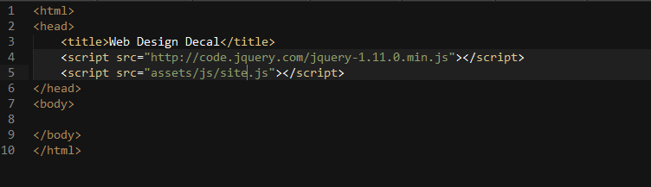
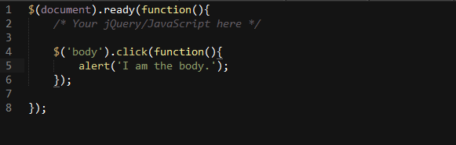
jQuery
Your HTML
Your Linked JavaScript File (assets/js/site.js)

Slide 47
Hands-On Activity

